Slide 1

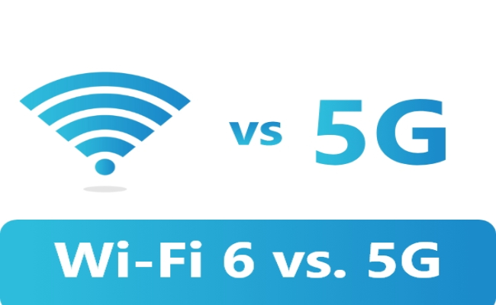
wifi vs 5G

Slide 2
AGENDA
INTRODUCTION
WHAT IS 5G
ADVANTAGES AND DISADVATAGES
WHAT IS WIFI
ADVANTAGES AND DISADVANTAGES
DIFFERENCES BETWEEN WIFI AND 5G

Slide 3

INTRODUCTION
Radio technologies have evidenced a rapid and multidirectional evolution with the launch of the analogue cellular systems in 1980s. Thereafter, digital wireless communication systems are consistently on a mission to fulfil the growing need of human beings (1G, …4G, or now 5G).

Slide 4
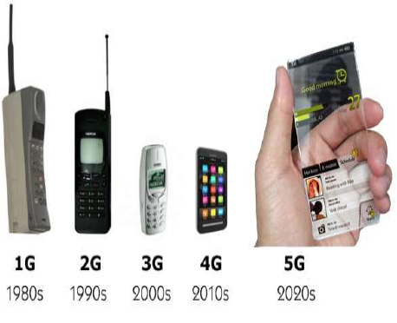
EVOLUTION TO 5G

Slide 5
5G launch in India
5G services in India were formally launched by Prime Minister Shri Narendra Modi on 1st October 2022, at the 6th edition of India Mobile Congress (IMC). The launch also saw the announcements by the private CSPs on providing 5G services across India by end of 2023- early 2024. Reliance Jio is planning for pan India 5G presence by end of 2023 while Bharti Airtel is aiming for a pan India footprint by end of March 2024. Vodafone Idea also announced that it plans to roll out 5G service in India soon.
While several cities including Delhi, Mumbai, Kolkata, Varanasi, Bangalore and others already have access to 5G services, over the next few months, the CSPs will be expanding the 5G services to newer areas and introducing new use cases. Nokia has already announced commercial deals with Reliance Jio and Bharti for 5G network deployment.

Slide 6
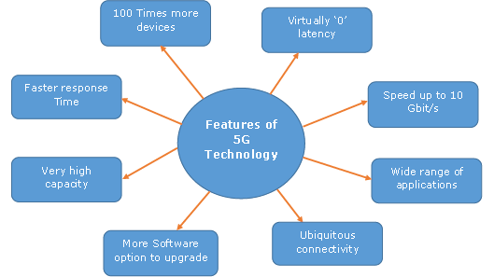

Slide 7
WHAT IS 5G
The 5G technology is expected to provide a new (much wider than the previous one) frequency bands along with the wider spectral bandwidth per frequency channel.
it is not only the increase in bitrate made 5G distinct from the 4G, but rather 5G is also advanced by implementing the following
High increased peak bit rate
Larger data volume per unit area (i.e. high system spectral efficiency)
High capacity to allow more devices connectivity concurrently and instantaneously
Lower battery consumption
Better connectivity irrespective of the geographic region, in which you are
Larger number of supporting devices
Lower cost of infrastructural development
Higher reliability of the communications

Slide 8
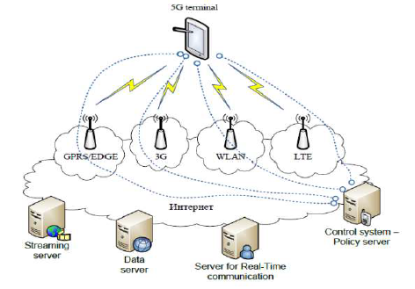
Architecture of 5G
The system model of 5G is entirely IP based model designed for the wireless and mobile networks.

Slide 9
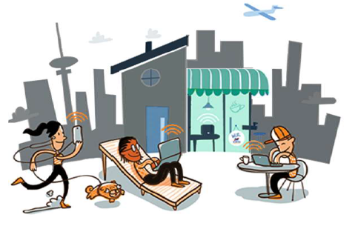
APPLICATIONS OF 5G
It will make unified global standard for all.
Network availability will be everywhere and will facilitate people to use their computer and such kind of mobile devices anywhere anytime.
Because of the IPv6 technology, visiting care of mobile IP address will be assigned as per the connected network and geographical position.
Its application will make world real Wi Fi zone.
Its cognitive radio technology will facilitate different version of radio technologies to share the same spectrum efficiently.
Its application will facilitate people to avail radio signal at higher altitude as well.

Slide 10

ADANCED FEATURES OF 5G
Practically possible to avail the super speed i.e. 1 to 10 Gbps.
Latency will be 1 millisecond (end-to-end round trip).
1,000x bandwidth per unit area.
Feasibility to connect 10 to 100 number of devices.
Worldwide coverage.
About 90% reduction in network energy usage.
Battery life will be much longer.
Whole world will be in wi fi zone.

Slide 11
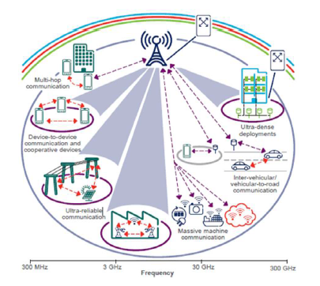
ADVANTAGES OF 5G
5th generation technology offers a wide range of features, which are beneficial for all group of people including, students, professionals (doctors, engineers, teachers, governing bodies, administrative bodies, etc.) and even for a common man.
High resolution and bi-directional large bandwidth shaping.
Technology to gather all networks on one platform.
More effective and efficient.
Technology to facilitate subscriber supervision tools for the quick action.
Most likely, will provide a huge broadcasting data (in Gigabit), which will support more than 60,000 connections.
Easily manageable with the previous generations.
Technological sound to support heterogeneous services (including private network).
Possible to provide uniform, uninterrupted, and consistent connectivity across the world.

Slide 12

DISADVANTAGES OF 5G
Many of the old devices would not be competent to 5G, hence, all of them need to be replaced with new one — expensive deal.
Developing infrastructure needs high cost

Slide 13

5G - Future Scope
5th generation technology is designed to provide incredible and remarkable data capabilities, unhindered call volumes, and immeasurable data broadcast within the latest mobile operating system..
Moreover, governments and regulators can use this technology as an opportunity for the good governance and can create healthier environments, which will definitely encourage continuing investment in 5G, the next generation technology.

Slide 14

WI-FI
WiFi stands for Wireless Fidelity. WiFiIt is based on the IEEE 802.11 family of standards and is primarily a local area networking (LAN) technology designed to provide in-building broadband coverage.
Current WiFi systems support a peak physical-layer data rate of 54 Mbps and typically provide indoor coverage over a distance of 100 feet.
WiFi has become the de facto standard for last mile broadband connectivity in homes, offices, and public hotspot locations. Systems can typically provide a coverage range of only about 1,000 feet from the access point
WiFi interfaces are now also being built into a variety of devices, including personal data assistants (PDAs), cordless phones, cellular phones, cameras, and media players.
WiFi networks operate in the unlicensed 2.4 radio bands, with an 11 Mbps (802.11b) or 54 Mbps (802.11a) data rate, respectively.

Slide 15
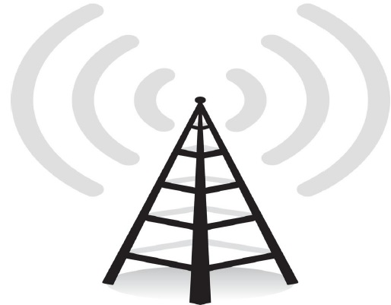
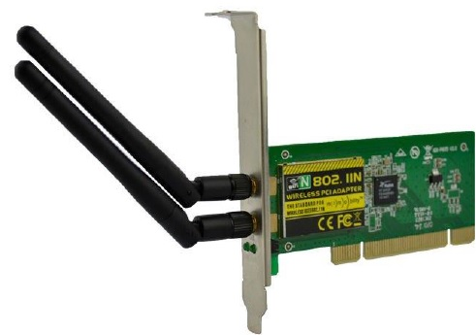

WORKING OF WI-FI
Radio Signals
Antennas work stronger and have a longer radio transmission with a radius of 300-500 feet, which are used in public areas while the weaker yet effective router is more suitable for homes with a radio transmission of 100-150 feet.
WiFi Cards
WiFi cards can be external or internal. If a WiFi card is not installed in your computer, then you may purchase a USB antenna attachment and have it externally connect to your USB port, or have an antenna-equipped expansion card installed directly to the computer
WiFi Hotspots
A WiFi hotspot is created by installing an access point to an internet connection. The access point transmits a wireless signal over a short distance. It typically covers around 300 feet.

Slide 16
Advantage Of WiFi 6
Following are the advantages of WiFi 6 system.
➨WiFi 6 provides 40% higher peak data rates and 4x improvement in network efficiency.
➨WiFi 6 based scheduling mechanism helps to reduce overhead and latency. Moreover multiple users can transmit simultaneously.
➨WiFi 6 client devices consume less power due to use of TWT (Target Wake Time) feature and hence it enhances battery life.
➨WiFi 6 offers higher security due to use of WPA3 protocol.
➨WiFi 6 uses long symbol duration outdoors and short symbol duration

Slide 17
DIS-ADVANTAGES OF WIFI
Security Problems − Security concerns have held back WiFi adoption in the corporate world. Hackers and security consultants have demonstrated how easy it can be to crack the current security technology known as wired equivalent privacy (WEP) used in most WiFi connections. A hacker can break into a WiFi network using readily available materials and software.
Compatibility and Interoperability − One of the major problems with WiFi is its compatibility and interoperability. For example, 802.11a products are not compatible with 802.11b products. Due to different operating frequencies, 802.11a hotspots would not help an 802.11b client. Due to lack of standardization, harmonization, and certification, different vendors come out with products that do not work with each other.
Billing Issues − WiFi vendors are also looking for ways to solve the problem of back-end integration and billing, which have dogged the roll-out of commercial WiFi hotspots. Some of the ideas under consideration for WiFi billing such as per day, per hour, and unlimited monthly connection fees.

Slide 18
Specifications | 5G | WiFi 6
• Technology | Cellular | WLAN
• Standard | 3GPP Rel. 15 and beyond | IEEE 802.11ax
• Operating frequency | Sub 1 GHz, 1 to 6 GHz, Greater than 6 GHz in millimeter wave range at 28 GHz and 40 GHz | 2.4 GHz and 5 GHz both
• Spectrum | Licensed | Unlicensed
• Speed | Greater than 1 Gbps | Higher than 5G, About 600 Mbps with 80MHz/1 SS, About 9.6 Gbps with 160 MHz/8SS (11ac version gives about 7 Gbps with 160 MHz, 8 SS).
• Range | 5G small cells support 10-100 meters range based on their types such as femtocell, pico cell and microcell. 5G mmwave base station covers 2 meters (in indoor) and 300 meters (in outdoor). | Greater than 100 meters, Beamforming feature improves range by 4 times than 802.11ac (i.e. wifi5) version.
• Maturity of the technology and its penetration | It is at nascent stages and will take few years to reach the current stage of 4G LTE deployments | It has already been matured and has deep penetration into our homes, enterprises, residential communities and commercial establishments
• Cost of deployment | Expensive | Cheaper
• IT administrators | Not required | Required as wifi networks are installed and managed by them
• Security | 5G cellular connections are more secure compare to unknown wifi connections. 5G users are exposed to security risks during process called wifi offloading. 5G will be as secure as 4G LTE today. 5G supports multiple authentication and key management features. | WiFi 6 supports WPA3 security protocols to provide high security.
• Mobility | Higher | Lower than 5G
• Application | Outdoors | Indoors

Slide 19
Conclusion
As indoor networks, wifi 6 offers low latency, high speed and greater device density compare to 5G.
5G provides broader geographic coverage and low latency, making it ideal for real-time applications.
On the other hand, Wi-Fi 6, operating over an unlicensed spectrum, offers high-speed connectivity and supports multiple devices in high-density environments. Hence, neither is inherently superior; the choice depends on specific user needs.
Moreover both 5G and WiFi 6 have their unique features. We can conclude that both the technologies are going to exist together. There is no chance that one will replace the other.
Both 5G and wifi-6 technologies have their unique use cases. Moreover in certain use cases, 5G can complement with wifi-6

